Slide 1
Spring Batch 101

Slide 2
Introduction
Requirements
  Automated, complex processing of large volumes of information efficiently processed with out human intervention.
  Periodic application of complex business rules across large data sets.
  Integration of information received from internal and external systems that typically requires formatting, validation and processing in a transactional manner into the system.
  Extraction of large data set for exporting to external systems.

Slide 3
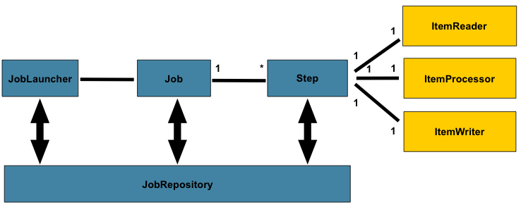

Slide 4
Configuring a Job (basic)
@Bean
public Job footballJob(JobRepository jobRepository,
Step playerLoad, Step gameLoad, Step playerSummarization) {
return new JobBuilder(“footballJob”, jobRepository)
.start(playerLoad)
.next(gameLoad)
.next(playerSummarization)
.build();
}

Slide 5
Configuring a Job (non restartable)
@Bean
public Job footballJob(JobRepository jobRepository,
Step playerLoad, Step gameLoad, Step playerSummarization) {
return new JobBuilder(“footballJob”, jobRepository)
.preventRestart()
.start(playerLoad)
.next(gameLoad)
.next(playerSummarization)
.build();
}

Slide 6
Java Configuration
@Configuration
@EnableBatchProcessing(
dataSourceRef = “batchDataSource”,
transactionManagerRef=”batchTransactionManager”)
public class BatchConfiguration {
@Bean
public DataSource batchDataSource() {
...
}
@Bean
public TransactionManager batchTransactionManager(DataSource batchDataSource) {
...
}
}

Slide 7
Java Configuration
@EnableBatchProcessing(
dataSourceRef = “batchDataSource”,
transactionManagerRef=”batchTransactionManager”)
Defines:
JobRepository -
JobLauncher
JobRegistry
JobExplorer
JobOperator

Slide 8
Java Configuration
@Configuration
public class BatchConfiguration extends DefaultBatchConfiguration {
@Bean
public Job jobName(JobRepository jobRepository, Step start) {
return new JobBuilder("job-name", jobRepository)
// Define job flow as needed
.build();
}
@Override
protected DataSource getDataSource() ...
@Override
protedted PlatformTransactionManager getPlatformTransactionManager() ...
}

Slide 9
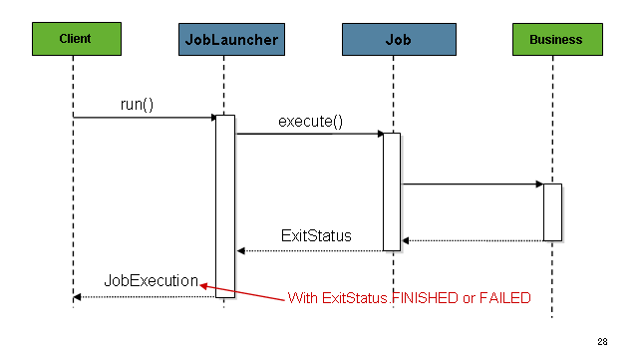
JobLauncher (Sync)
@Bean
public JobLauncher jobLauncher(JobRepository jobRepository) throws Exception {
TaskExecutorJobLauncher jobLauncher = new TaskExecutorJobLauncher();
jobLauncher.setJobRepository(jobRepository);
jobLauncher.afterPropertiesSet();
return jobLauncher;
}

Slide 10
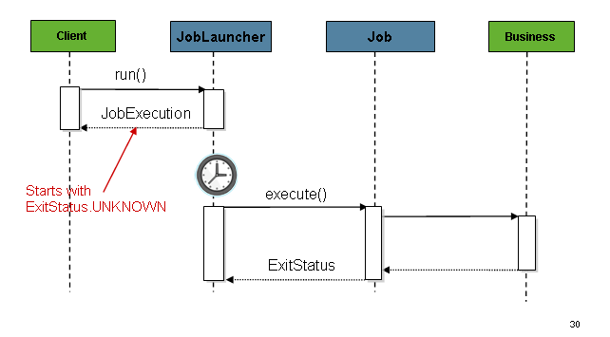
JobLauncher (Async)
@Bean
public JobLauncher jobLauncher(JobRepository jobRepository) throws Exception {
TaskExecutorJobLauncher jobLauncher = new TaskExecutorJobLauncher();
jobLauncher.setJobRepository(jobRepository);
jobLauncher.setTaskExecutor(new SimpleAsyncTaskExecutor());
jobLauncher.afterPropertiesSet();
return jobLauncher;
}

Slide 11
Querying the Repository
interface JobExplorer {
List<JobInstance> getJobInstances(String jobName, int start, int count);
JobExecution getJobExecution(Long executionId);
StepExecution getStepExecution(Long jobExecutionId, Long stepExecutionId);
JobInstance getJobInstance(Long instanceId);
List<JobExecution> getJobExecutions(JobInstance jobInstance);
Set<JobExecution> findRunningJobExecutions(String jobName);
}

Slide 12
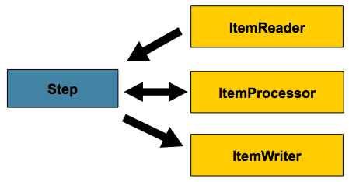
Configuring a Step

Slide 13
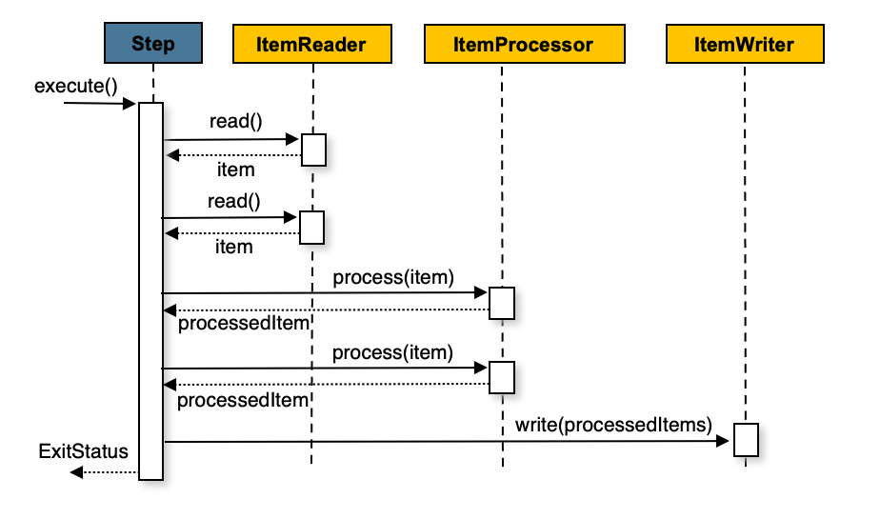
Chunk oriented processing
var step = new StepBuilder("stepName", jobRepository)
.<?, ?>chunk(2, transactionManager)
.reader(reader())
.itemProcessor(processor())
.writer(writer())
.build();

Slide 14
ItemReader and ItemWriter
public interface ItemReader<T> {
T read() throws Exception, UnexpectedInputException, ParseException, NonTransientResourceException
}
public interface ItemWriter<T> {
void write(Chunk<? extends T> items) throws Exception;
}

Slide 15
ItemStream
public interface ItemStream {
void open(ExecutionContext executionContext) throws ItemStreamException;
void update(ExecutionContext executionContex) thows ItemStreamException;
void close() throws ItemStreamException;
}

Slide 16
Flat Files
FieldSet
String[] tokens = new String[]{"foo", "1", "true"};
FieldSet fs = new DefaultFieldSet(tokens);
String name = fs.readString(0);
int value = fs.readInt(1);
boolean booleanValue = fs.readBoolean(2);
public interface LineMapper<T> {
T mapLine(String line, int lineNumber) throws Exception;
}

Slide 17
Flat Files
FlatFileItemReader
FlatFileItemWriter

Slide 18
More
Creating custom ItemReaders and ItemWriters
Online documentation

Slide 19
Questions

Slide 20
Thanks

